Slide 1


Hands-On SAP Business Technology Platform ABAP Environment

Slide 2
Practical No.1 Creating a BTP ABAP Environment
Create an SAP BTP ABAP Environment Trial User
Step-1
In your web browser, open the https://cockpit.hanatrial.ondemand.com/.
Navigate to the trial global account by clicking Go to Your Trial Account.

Slide 3
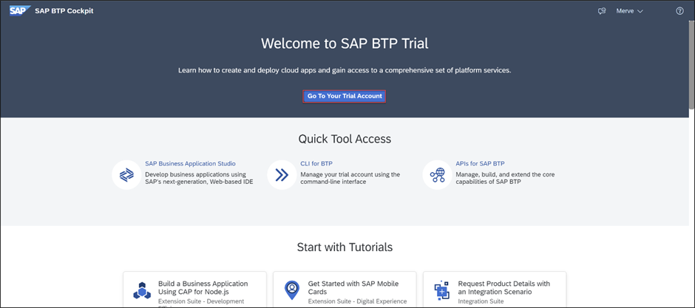

Slide 4
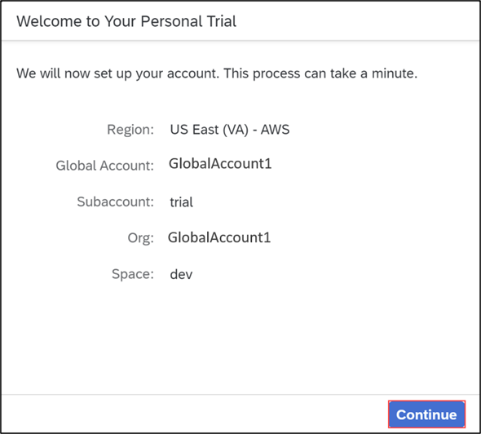
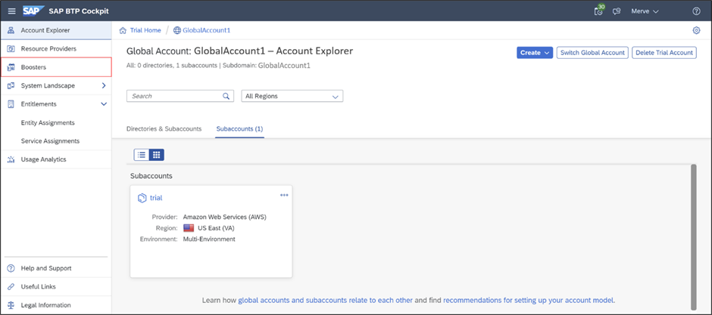
Choose Continue.
From your global account page, choose Boosters on the left side.

Slide 5
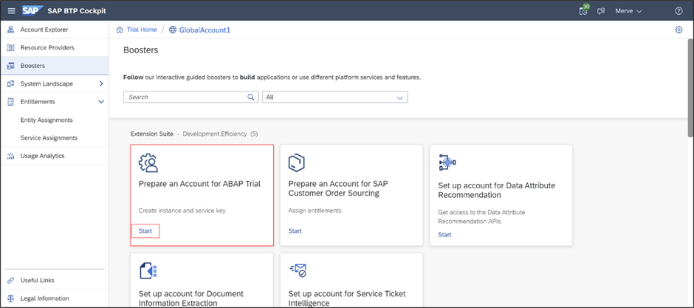
Search the Prepare an Account for ABAP Trial tile and press Start to start your booster. If you already created a service instance and service key, then please skip this step and move on with Step 2. Only one service instance can be created at a time.

Slide 6
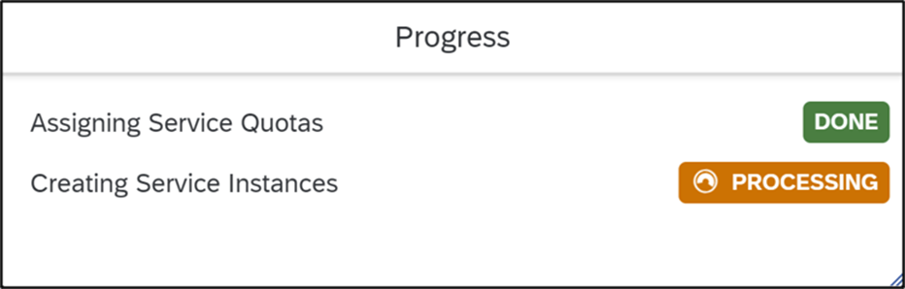
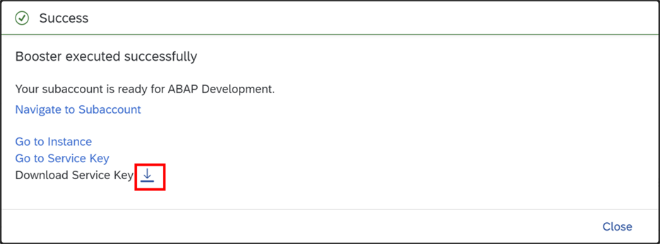
Now the service instance and service key will be created for the ABAP trial user. The service key can be found inside the service instance.
The booster is now executed successfully. Download your service key for later use.

Slide 7
Step 2
Open ABAP Development Tools
Open Eclipse. Make sure you have installed ADT in your Eclipse.
To install the front-end component of ADT, proceed as follows:
Get an installation of Eclipse 2022-09 (x86_64) (Eclipse IDE for Java Developers)
In Eclipse, choose in the menu bar Help > Install New Software...
Enter the URL https://tools.hana.ondemand.com/latest
Press Enter to display the available features.
Select ABAP Development Tools and choose next.
On the next wizard page, you get an overview of the features to be installed. Choose Next.
Confirm the license agreements and choose Finish to start the installation.

Slide 8
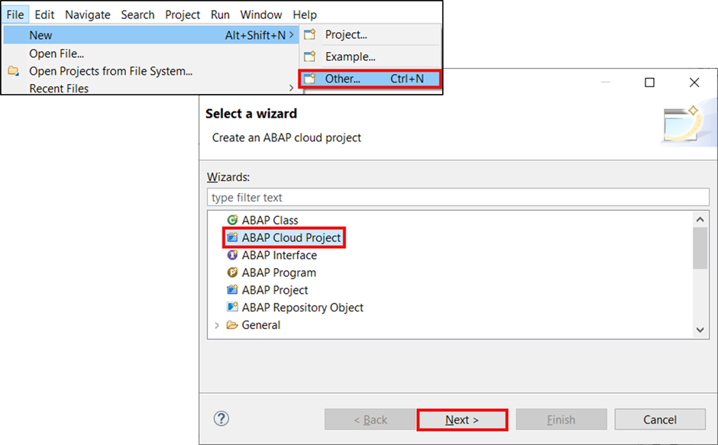
Step 3 Create ABAP cloud project
Select File > New > Other > ABAP Cloud Project and click Next >.

Slide 9
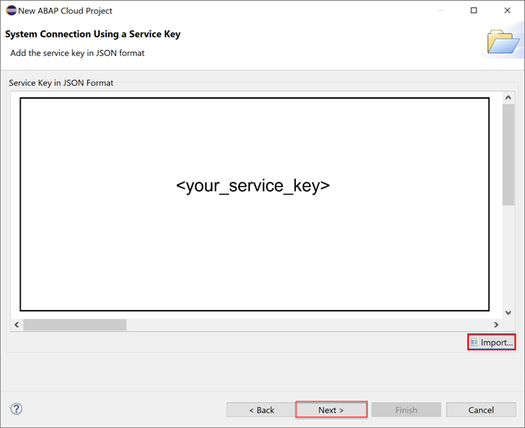
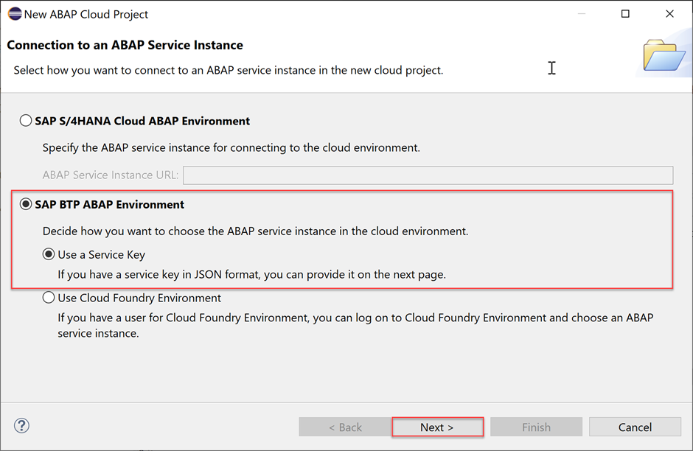
2. Select SAP BTP ABAP Environment > Use a Service Key and click Next >.
3. Import your service key and click Next >.

Slide 10
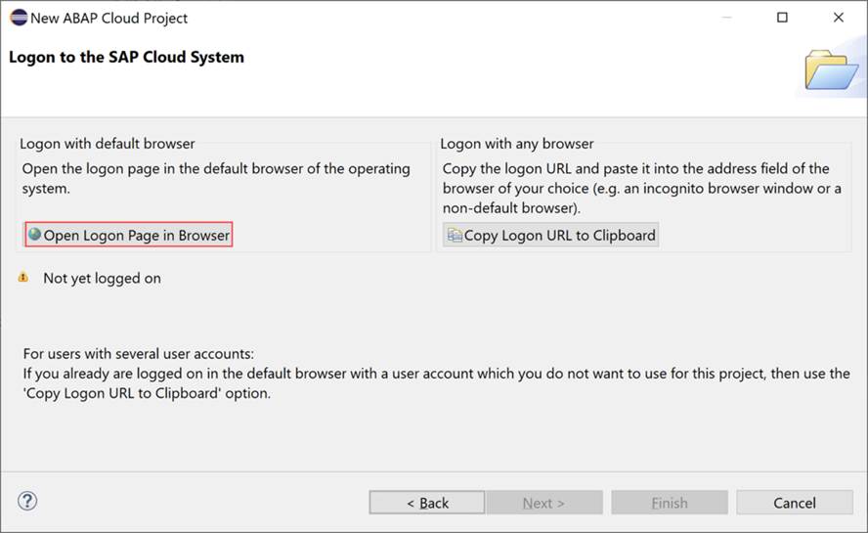
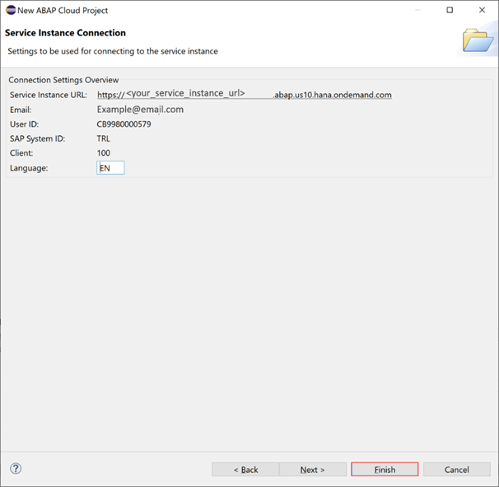
4. Click Open Logon Page in Browser.
5. Now you’ve been authenticated automatically. Provide your credentials if requested. The credentials are the same you used to create your trial account on SAP BTP.

Slide 11
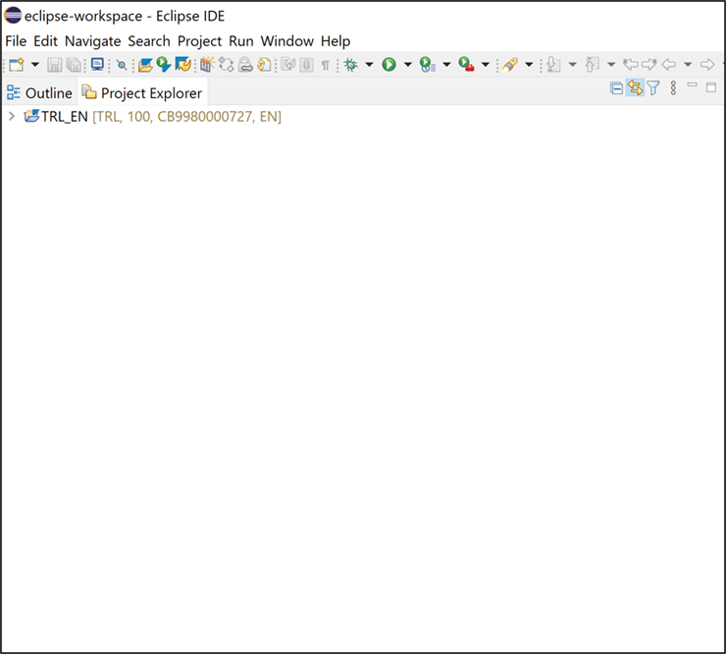
6. Your trial system appears on the project explorer.

Slide 12
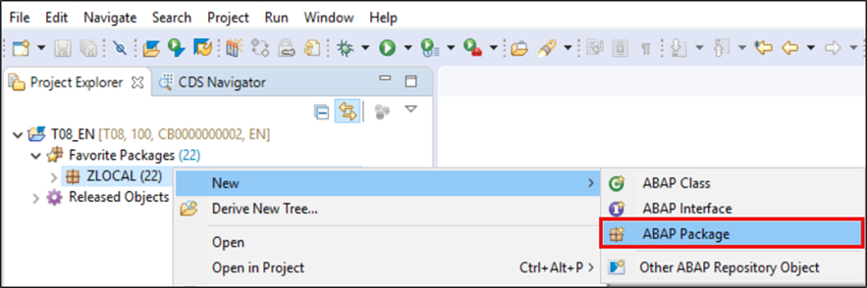
Practical No.2 Creating an ABAP Package
In this practical, wherever XXX appears, use a number.
Open ABAP Development Tools (ADT) and select your ABAP Cloud Project you created in Create a SAP BTP ABAP Environment Trial User.
Right-click on ZLOCAL and select New > ABAP Package.

Slide 13
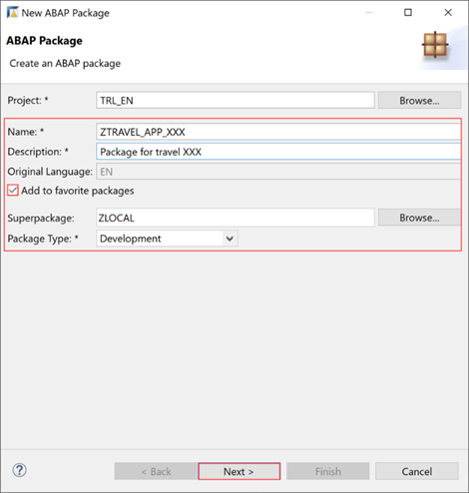
2. Create a new ABAP package:
Name: ZTRAVEL_APP_XXX
Description: Package for travel XXX
Superpackage: ZLOCAL
Check Add to favorite packages.
Click Next

Slide 14
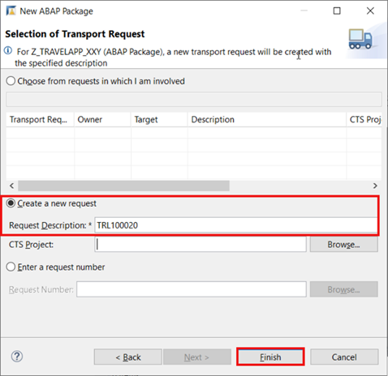
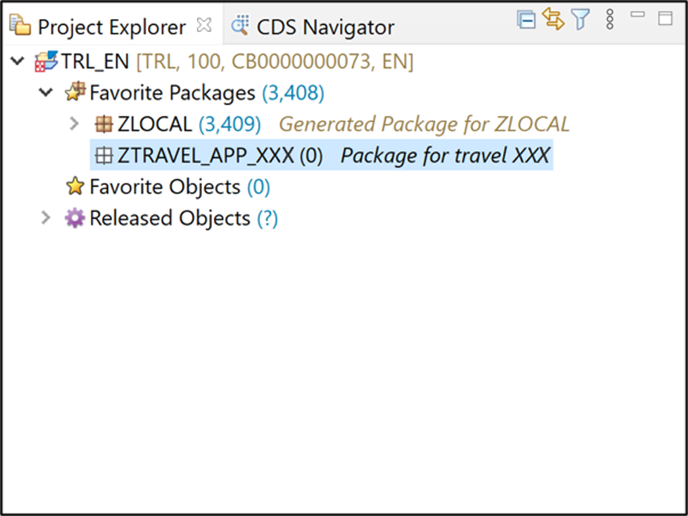
3. Select Create new request and enter a request description.
4. Now your package is added to favorite objects.

Slide 15
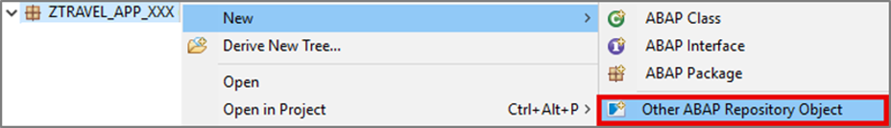
Practical No.3 Creating a Database Table
Right-click on your package ZTRAVEL_APP_XXX, select New > Other ABAP Repository Object.

Slide 16
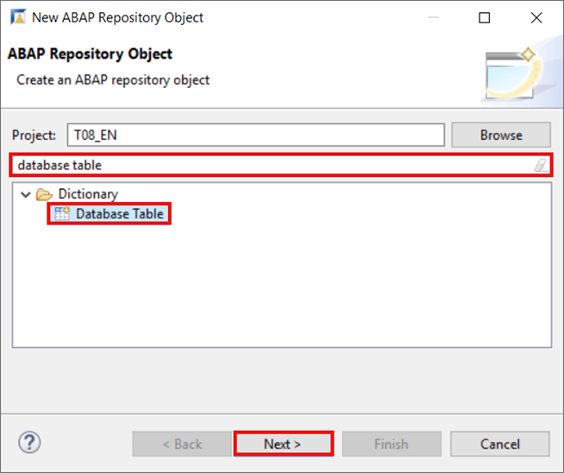
2. Search for database table, select it and click Next >.

Slide 17
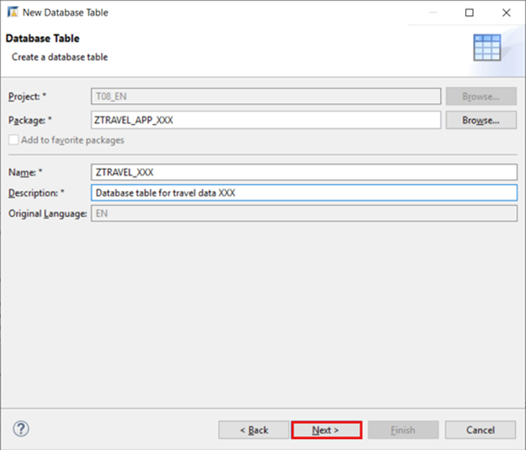
3. Create a new database table:
Name: ZTRAVEL_XXX
Description: Database table for travel data XXX
Click Next.

Slide 18
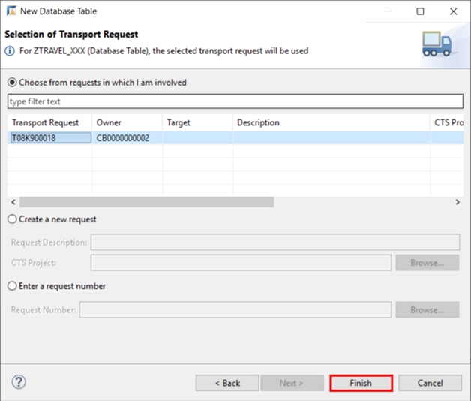
4. Click Finish to create your transport request.

Slide 19
5. Replace your code with following:
6. Save and Activate
Save – Ctrl + S
Activate – Ctrl+F3
@EndUserText.label : 'Database table for travel data XXX'
@AbapCatalog.enhancementCategory : #NOT_EXTENSIBLE
@AbapCatalog.tableCategory : #TRANSPARENT
@AbapCatalog.deliveryClass : #A
@AbapCatalog.dataMaintenance : #RESTRICTED
define table ztravel_xxx {
key client : abap.clnt not null;
key mykey : sysuuid_x16 not null;
travel_id : /dmo/travel_id;
agency_id : /dmo/agency_id;
customer_id : /dmo/customer_id;
begin_date : /dmo/begin_date;
end_date : /dmo/end_date;
@Semantics.amount.currencyCode : 'ztravel_xxx.currency_code'
booking_fee : /dmo/booking_fee;
@Semantics.amount.currencyCode : 'ztravel_xxx.currency_code'
total_price : /dmo/total_price;
currency_code : /dmo/currency_code;
description : /dmo/description;
overall_status : /dmo/overall_status;
created_by : syuname;
created_at : timestampl;
last_changed_by : syuname;
last_changed_at : timestampl;
}

Slide 20
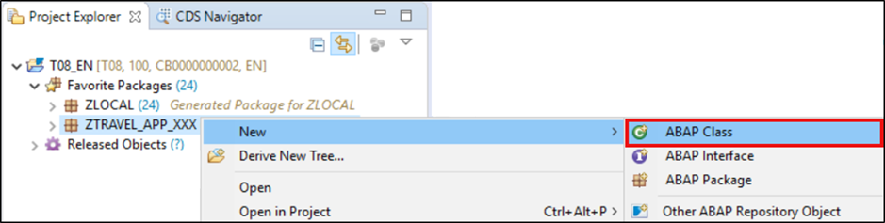
Practical No.4 Creating an ABAP Class
Right-click on your package ZTRAVEL_APP_XXX, select New > ABAP Class.

Slide 21
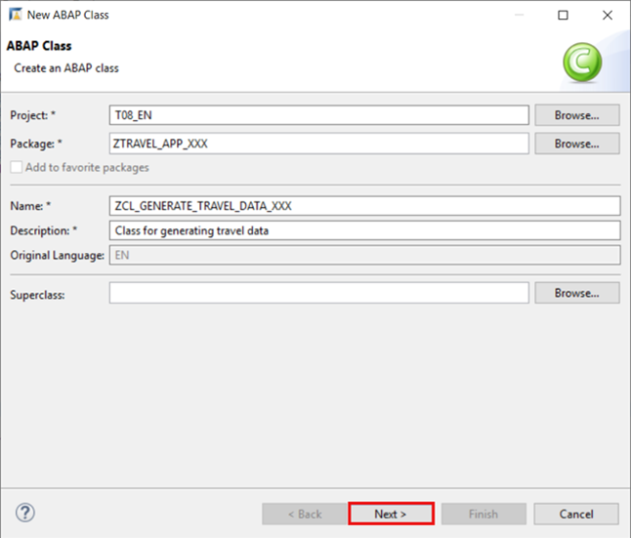
2. Create a new ABAP class:
Name: ZCL_GENERATE_TRAVEL_DATA_XXX
Description: Class for generating travel data
Click Next >.

Slide 22
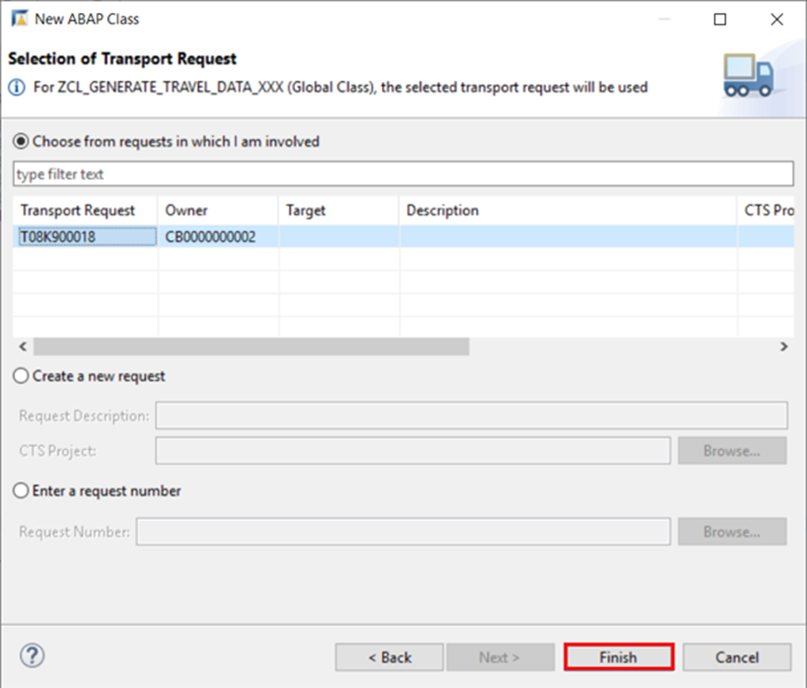
3. Click Finish to create your transport request.

Slide 23
Practical No.5 WAP to print Hello World
Create a New Class “zcl_generate_travel_data_yyy” and paste the following code.
CLASS zcl_generate_travel_data_yyy DEFINITION
PUBLIC
FINAL
CREATE PUBLIC .
PUBLIC SECTION.
INTERFACES if_oo_adt_classrun.
PROTECTED SECTION.
PRIVATE SECTION.
ENDCLASS.
CLASS zcl_generate_travel_data_yyy IMPLEMENTATION.
METHOD if_oo_adt_classrun~main.
* output the result as a console message.
out->write( '|Hello World |').
ENDMETHOD.
ENDCLASS.

Slide 24
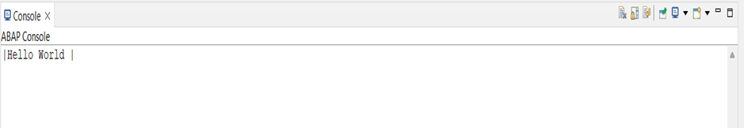
Output:

Slide 25
Practical No.6. Insert Data Table Entries and print them on the console
Open the class first created “zcl_generate_travel_data_xxx” and paste the following code
CLASS zcl_generate_travel_data_xxx DEFINITION
PUBLIC
FINAL
CREATE PUBLIC .
PUBLIC SECTION.
INTERFACES if_oo_adt_classrun.
PROTECTED SECTION.
PRIVATE SECTION. ENDCLASS.

Slide 26
CLASS zcl_generate_travel_data_xxx IMPLEMENTATION.
METHOD if_oo_adt_classrun~main.
DATA itab TYPE TABLE OF ztravel_xxx.
* fill internal travel table (itab)
itab = VALUE #(
( mykey = '02D5290E594C1EDA93815057FD946624' travel_id = '00000022' agency_id = '070001' customer_id = '000077' begin_date = '20190624' end_date = '20190628' booking_fee = '60.00' total_price = '750.00' currency_code = 'USD'
description = 'mv' overall_status = 'A' created_by = 'MUSTERMANN' created_at = '20190612133945.5960060' last_changed_by = 'MUSTERFRAU' last_changed_at = '20190702105400.3647680' )
( mykey = '02D5290E594C1EDA93815C50CD7AE62A' travel_id = '00000106' agency_id = '070005' customer_id = '000005' begin_date = '20190613' end_date = '20190716' booking_fee = '17.00' total_price = '650.00' currency_code = 'AFN'
description = 'Enter your comments here' overall_status = 'A' created_by = 'MUSTERMANN' created_at = '20190613111129.2391370' last_changed_by = 'MUSTERMANN' last_changed_at = '20190711140753.1472620' )
( mykey = '02D5290E594C1EDA93858EED2DA2EB0B' travel_id = '00000103' agency_id = '070010' customer_id = '000011' begin_date = '20190610' end_date = '20190714' booking_fee = '17.00' total_price = '800.00' currency_code = 'AFN'
description = 'Enter your comments here' overall_status = 'X' created_by = 'MUSTERFRAU' created_at = '20190613105654.4296640' last_changed_by = 'MUSTERFRAU' last_changed_at = '20190613111041.2251330' )
).
* delete existing entries in the database table
DELETE FROM ztravel_xxx.
* insert the new table entries
INSERT ztravel_xxx FROM TABLE @itab.
* output the result as a console message
out->write( |{ sy-dbcnt } travel entries inserted successfully!| ).
ENDMETHOD.
ENDCLASS.

Slide 27
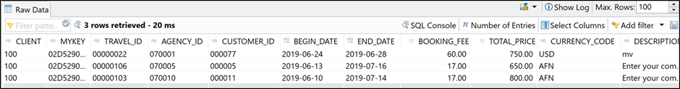
Save, activate and click F9 to run your ABAP class.
Save – Ctrl + S
Activate – Ctrl + F3
Run – F9
Check your result. Therefore, open your database table ZTRAVEL_XXX and press F8 to see your data. Now the dictionary tables are filled with data.

Slide 28
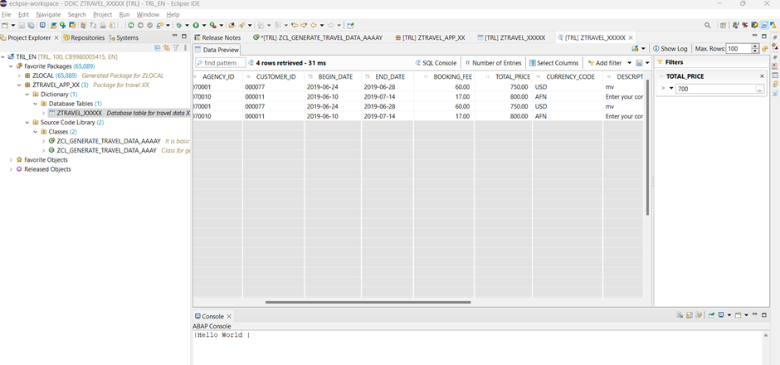
Practical No.7 Perform Query Operation on the Output Table
How to extract the records having Total Price > 700
Click on “Add Filter”. Click on Total Price and write the condition

Slide 29
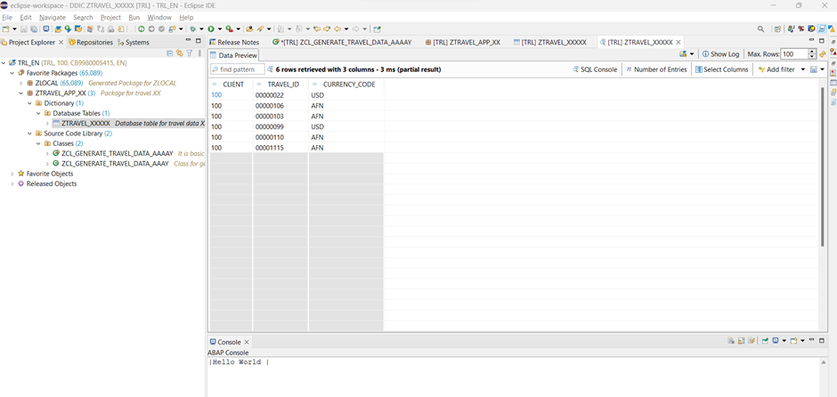
2. Click on Select Columns and Select the columns you want to display

Slide 30
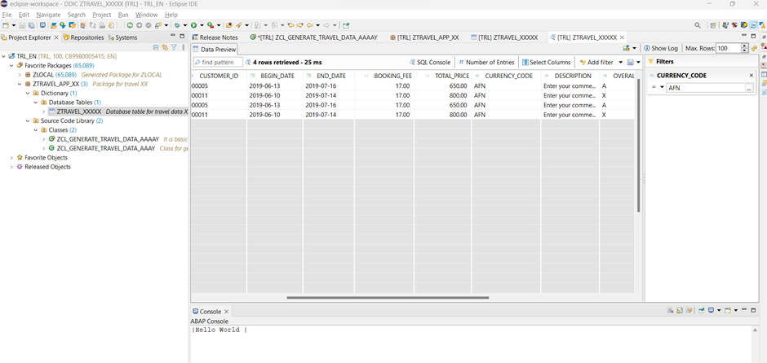
3. Filter the Country Code = ‘AFN’ from the data

Slide 31
References
https://learning.sap-press.com/abap
https://www.sap.com/documents/2018/08/7a62516c-157d-0010-87a3-c30de2ffd8ff.html
https://open.sap.com/courses/mm4h2

